Slide 1
Create Widget
Calvin
2013.03.04

Slide 2
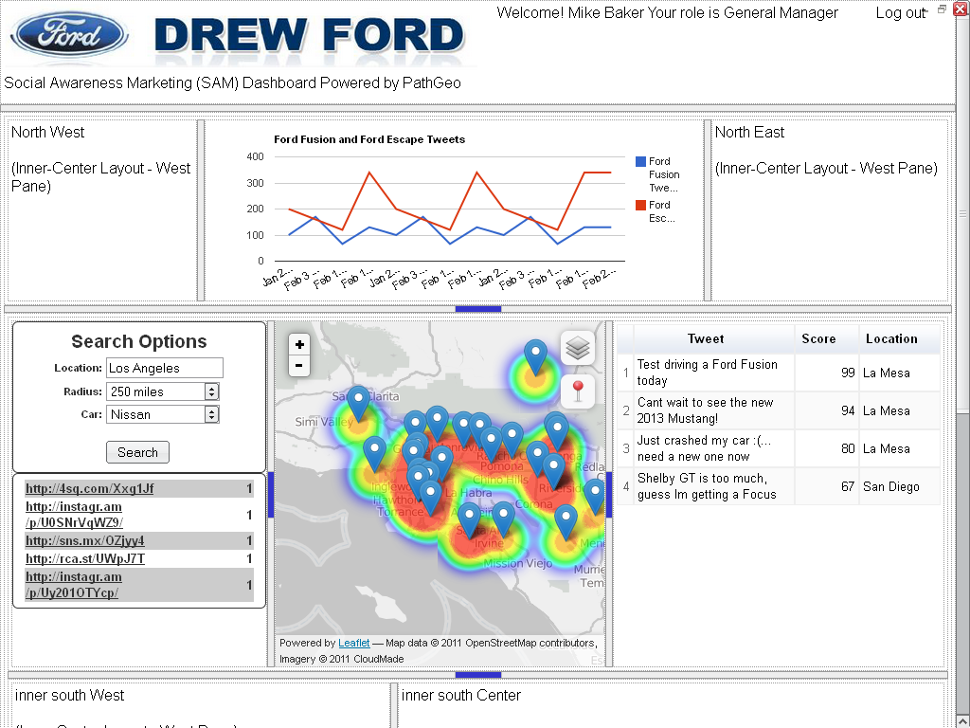
Su’s Layout (http://vision.sdsu.edu/suhan/layout/)
Pros:
resizable
Cons:
Cannot draggable (cannot meet Bryan’s requirements)

Slide 3
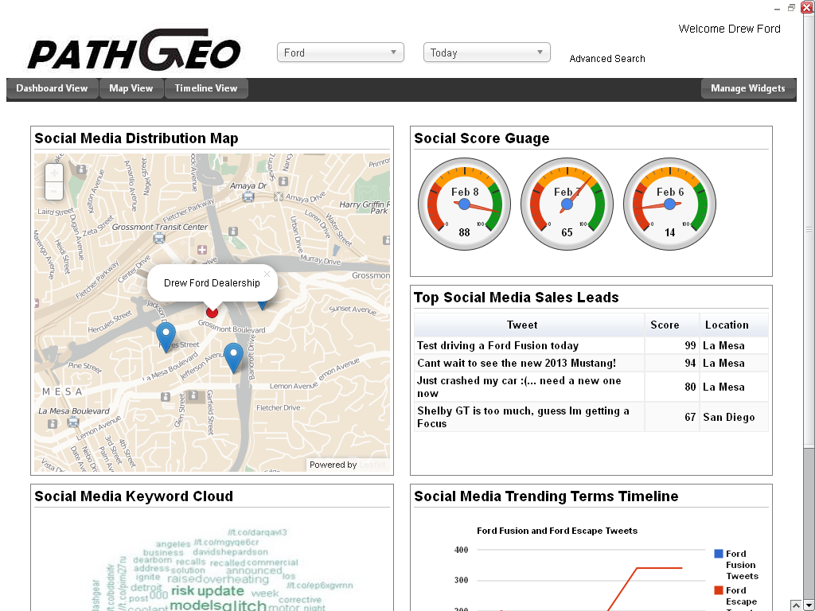
Joe’s Layout (http://vision.sdsu.edu/jsalt/layout2/)
Pros:
draggable
Cons:
Cannot resizable
The box size are limited to the same width (ex: 4x2, 4x3, or 4x4)
The layout is limited to 2 columns.

Slide 4
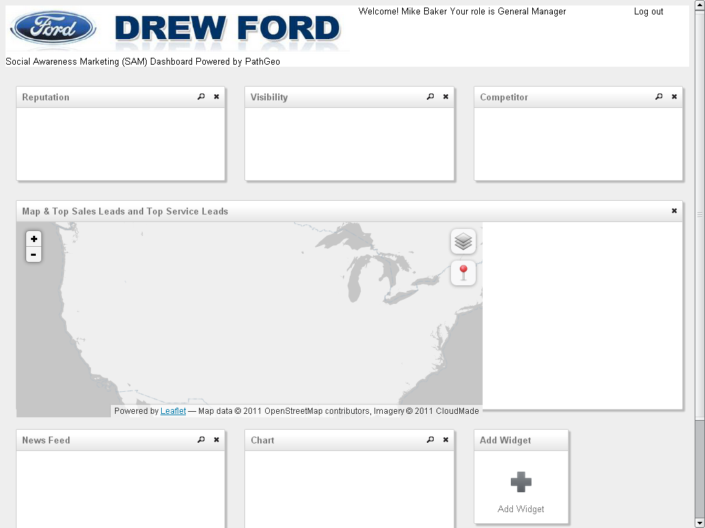
Widget
Widget
Widget
Widget
Gridster Layout (http://vision.sdsu.edu/calvin/demo/)
Pros:
Draggable
The box can be anywhere and any size.
OpenSource, under MIT license (Gridster: http://gridster.net/)
Cons:
Cannot resizable
Widget
Widget
Widget

Slide 5
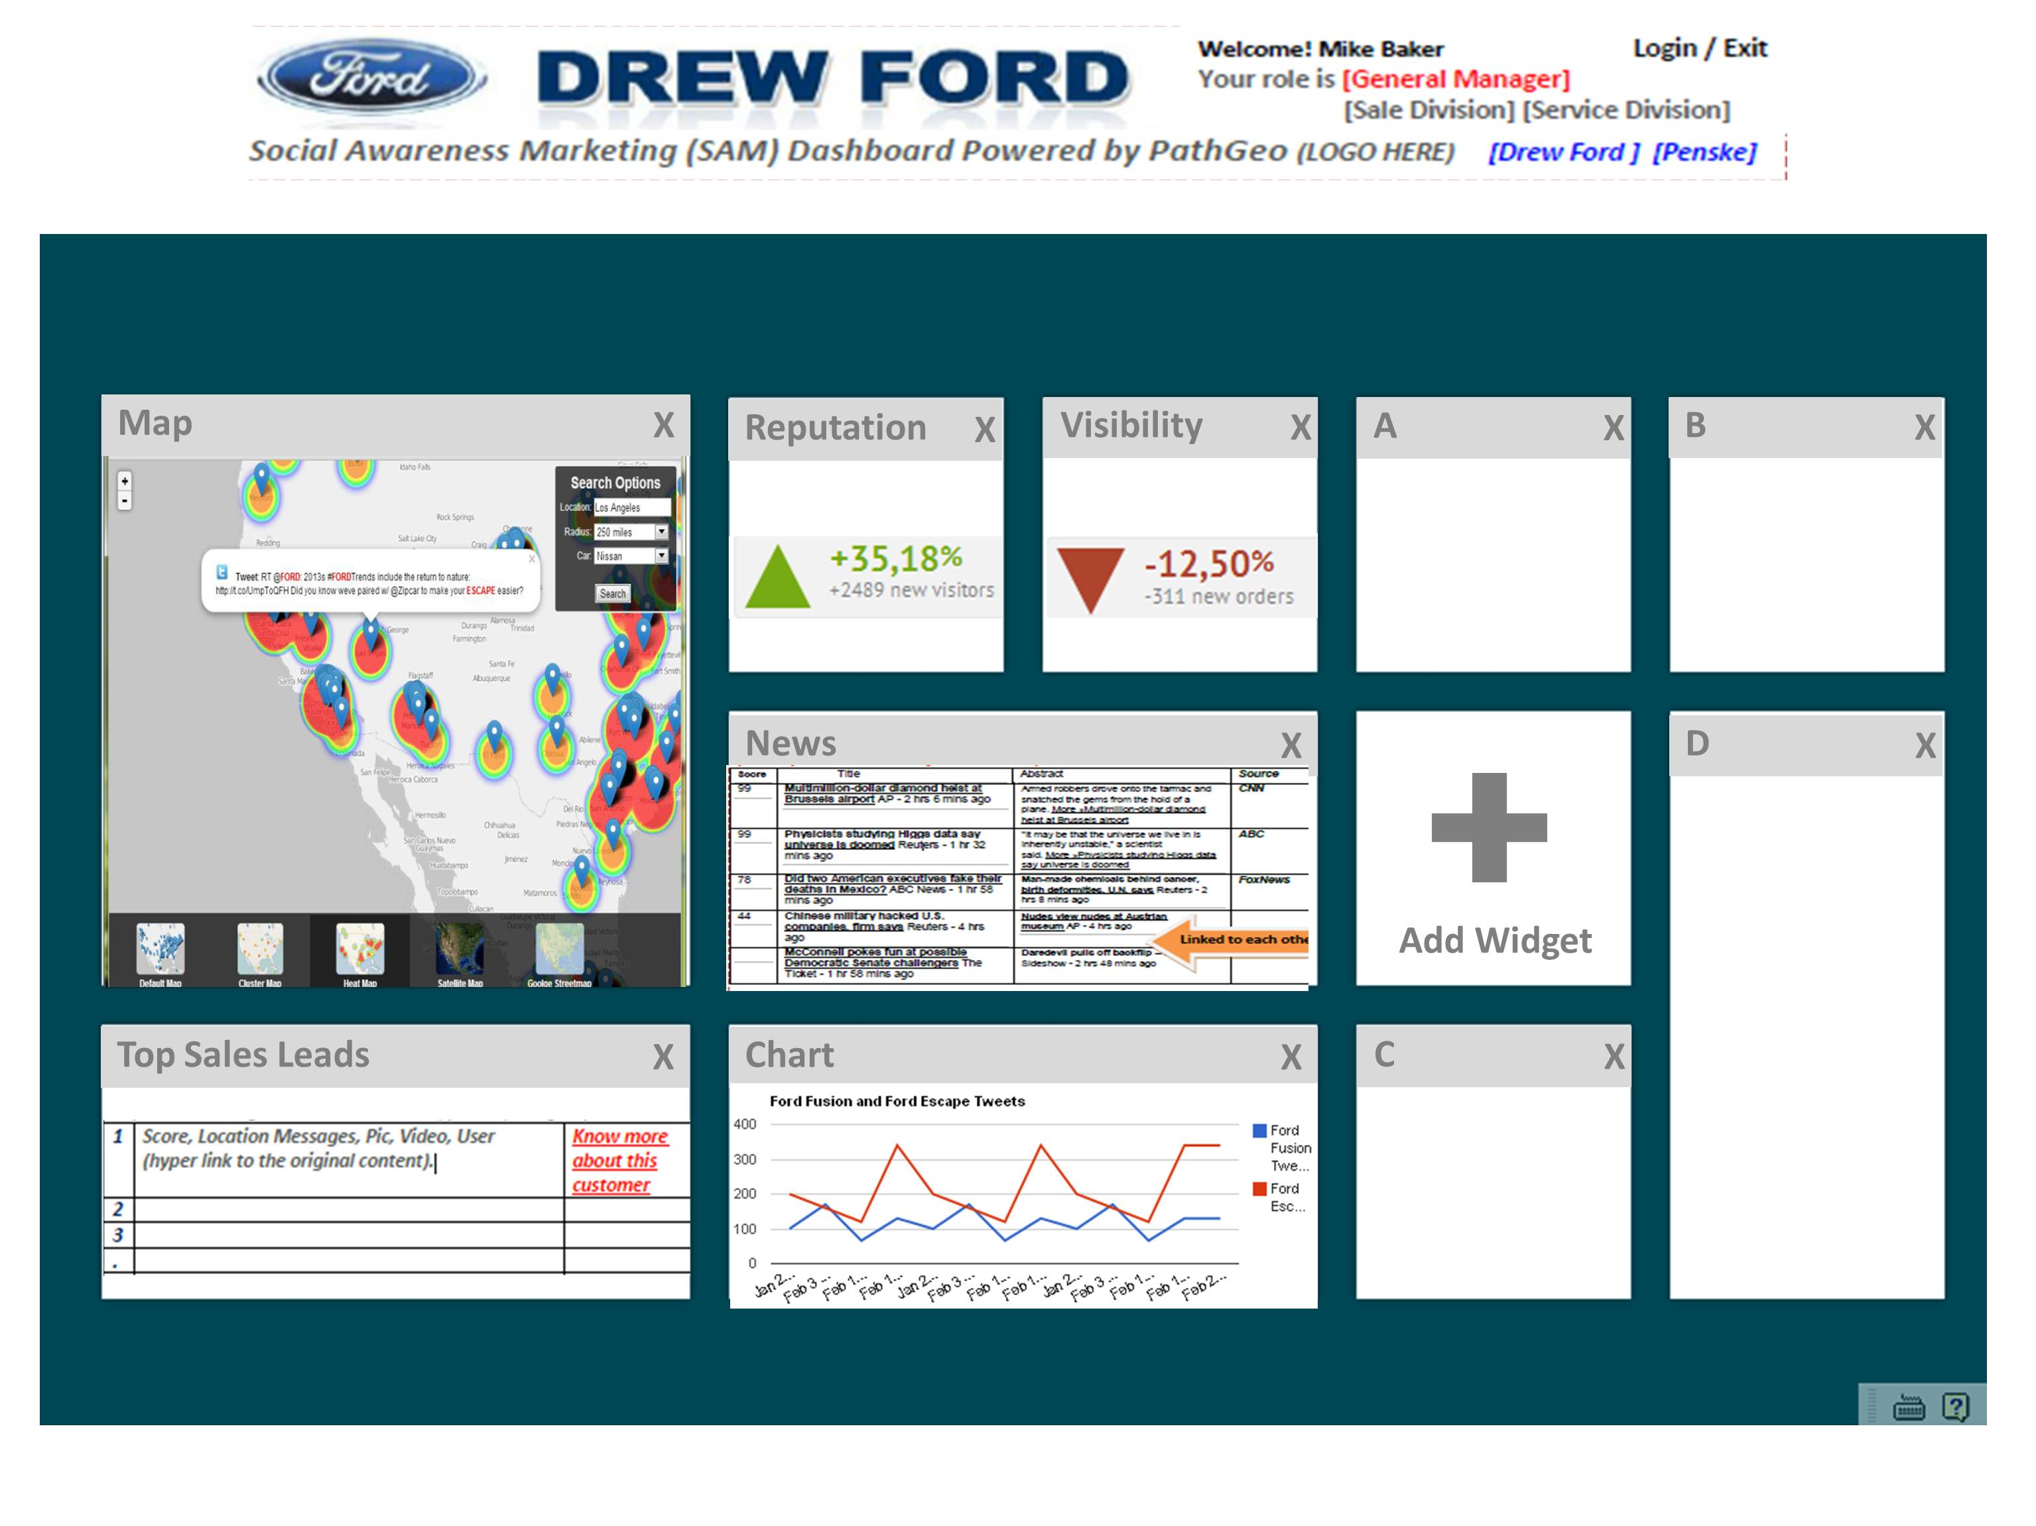

Slide 6
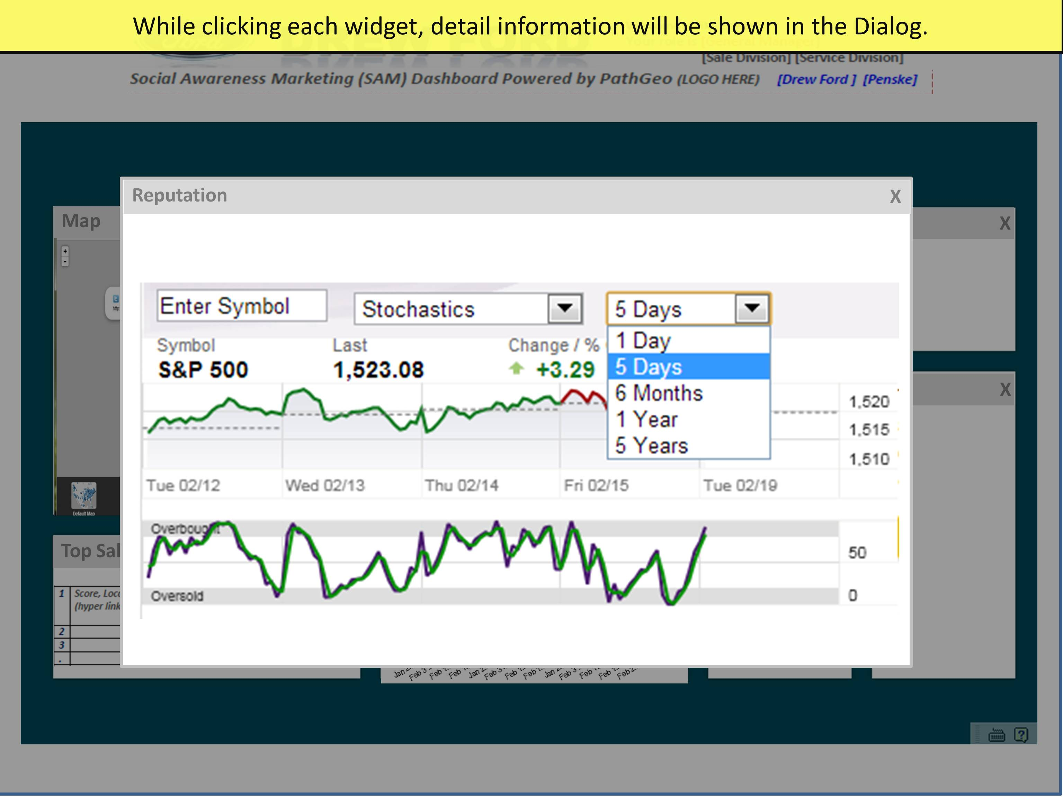

Slide 7
Widget
Widget
Widget
Widget
DEMO Time
http://vision.sdsu.edu/calvin/demo
Widget
Widget
Widget

Slide 8
//Each widget are implemented in DIV
<div
id='widget_map' //widget DOM ID
class='widget' //widget css class
widget-title='Map & Top Sales Leads and Top Service Leads' //widget title
widget-onInit="init_map()" //the function will be called when the widget is ready
widget-onClose="" //the function will be called when the widget is closed
widget-onClick="" //the function will be called when the widget is clicked
widget-sizeX=6 //the widget size X (from 1 to 6)
widget-sizeY=2 //the widget size Y (from 1 to 6)
widget-row=2 //the widget position: row
widget-col=1> //the widget position: column
<div id='map' style='width:70%; height:94%;'></div> //the layout in the widget
<div style='width:30%; height:94%;'></div>
</div>

Slide 9
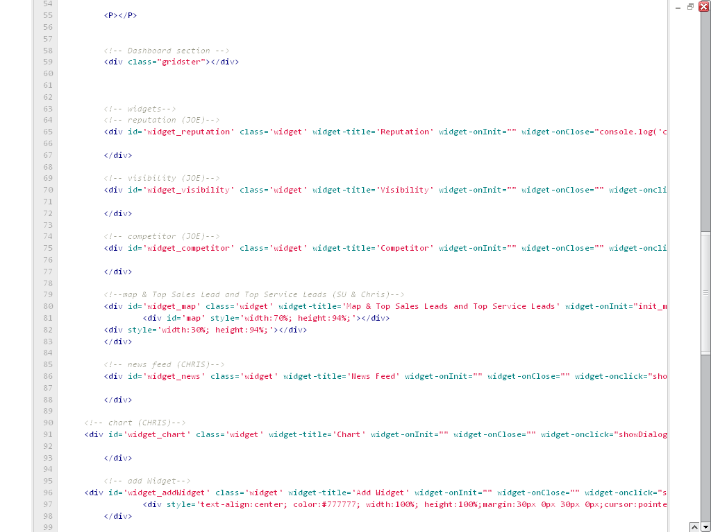

Slide 10
